Slide 1
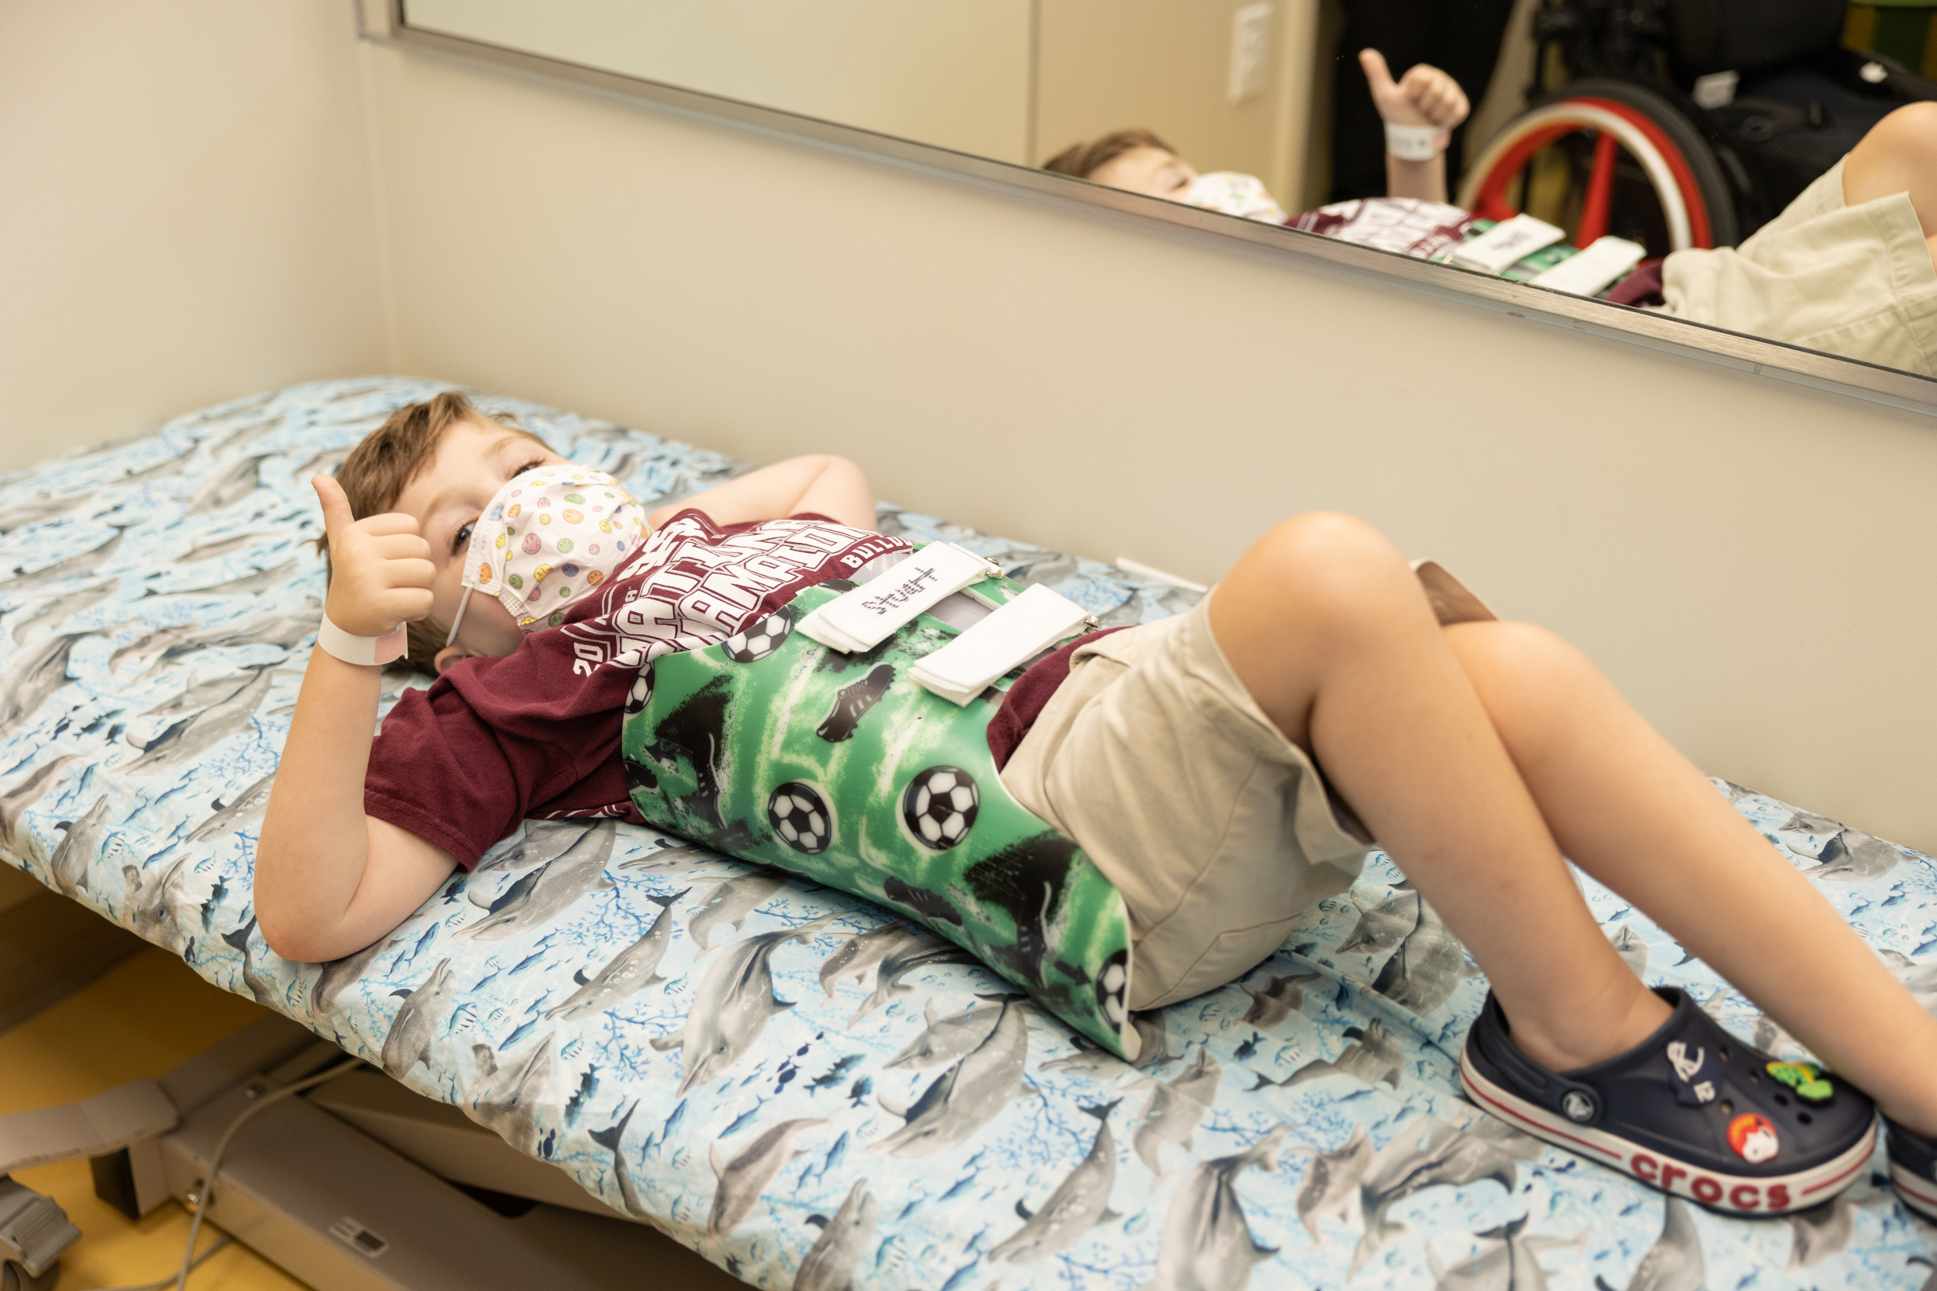
Boys with Idiopathic Scoliosis Treated with Nighttime Bracing Have Similar Outcomes to Girls
Authors: Karina Zapata, Dan Sucato, James McGinley, Kara Davis, ChanHee Jo, Megan Johnson
Scottish Rite for Children, Dallas, Texas, USA
INTRODUCTION
 | Boys (n=65) | Girls (n=241) | p-value
Initial age (years) | 13.8±1.5 | 12.3±1.2 | <0.001*
Initial body mass index (kg/m²) | 18.2±3.6 | 18.1±2.7 | 0.41
Initial primary curve
Thoracic | 5% | 16% | 0.049*
Thoracolumbar | 55% | 50%
Lumbar | 40% | 34%
Brace design
Double | 20% | 34% | 0.13
Thoracolumbar | 66% | 50%
Lumbar | 14% | 15%
Initial Risser stage
0 | 63% | 76% | 0.005*
1 | 9% | 12%
2 | 26% | 11%
Initial triradiate cartilage (open) | 46% | 46% | 0.94
Initial menarchal status (Pre) | NA | 70%
Initial curve magnitude (°) | 24±4 | 24±4 | 0.63
In-brace correction (%) | 103±29 | 103±29 | 0.93
Years braced | 2.3±0.9 | 2.2±0.9 | 0.29
Total brace wear (hr/day) | 6.4±2.5 | 6.9±2.4 | 0.087
Growth (cm) | 11.8±7.1 | 9.4±5.7 | 0.029*
Final age (years) | 16.5±2.5 | 15.1±1.4 | <0.001*
Final curve magnitude (°) | 28±13 | 26±10 | 0.44
Final curve progression (°) | 4±12 | 2±9 | 0.6
Final curve less than 30° (%) | 60% | 67% | 0.29
Curve improved ≥6° | 17% | 20% | 0.59
Curve progressed ≥6° | 32% | 31% | 0.8
Progression to full-time brace | 8% | 11% | 0.5
Progression to surgery | 8% | 4% | 0.119
CONCLUSIONS
The few studies evaluating brace treatment outcomes specific to boys have found inferior results. The effectiveness of nighttime Providence bracing in boys with idiopathic scoliosis (IS) is unknown. The purpose is to evaluate the effectiveness of nighttime brace treatment in boys with IS compared to girls.
Boys with idiopathic scoliosis with predominantly TL/lL curves treated in Providence braces have excellent brace wear and treatment outcomes. Though surgical rates trended higher in boys than girls for curves <25° and thoracic curves, neither reached statistical significance.
METHODS
SIGNIFICANCE
306 children (65 boys, 241 girls) with IS ages 10-16 years, Risser stages 0 to 2, major curves 15° to 40° with predominantly thoracolumbar (TL)/lumbar (L) curves treated with Providence nighttime braces prescribed ≥8 hours per night were retrospectively reviewed until either skeletal maturity or surgery. Brace adherence was measured using iButton temperature sensors at brace discharge (n=242). Brace outcomes included curve progression ≥6° and progression to surgery among boys versus girls and curves <25°, ≥25°, thoracic, and TL/L curves.
Contrary to the literature from full-time bracing, boys and girls with IS treated with nighttime bracing demonstrate similar results. Nighttime bracing for boys should be offered more frequently as a highly effective non-operative treatment approach.
RESULTS
At brace prescription, boys were older, had a more advanced Risser stage than girls, and had a smaller proportion of thoracic curves (5% vs. 16%), but did not differ by curve magnitude (24° vs. 24°), triradiate cartilage status, body mass index, or years braced (Table). In-brace
correction was similar (103% boys vs. 103% girls). At final visit, boys grew more (11.8 cm vs. 9.4 cm, p=0.029), Boys had similar brace wear adherence throughout the entire duration of brace wear to girls (6.4 hours vs. 6.9 hours, p=0.09). Boys also had similar curve progression (4° vs. 2°, p=0.60) from brace prescription to final visit and similar rates of progression to surgery (8% vs. 4%, p=0.19). Boys with curves <25° (n=39) had similar rates of progression as girls (3° vs. 2°) and statistically similar progression to surgery (8% vs. 1%, p=0.06). Boys with curves ≥25° (n=26) also had similar progression as girls (5° vs. 3°) and had similar rates of surgery (8% vs. 8%, p=0.99). Boys with thoracic curves (n=7) and TL/L curves (n=58) progressed similarly (2° vs. 4°; 4° vs. 2°, p=0.10, respectively) and required surgery at statistically similar rates to girls (14% vs. 4%, p=0.34; 7% vs 4%).
REFERENCES
[1] Bohl DD, Telles CJ, Golinvaux NS, Basques BA, DeLuca PA, Grauer JN. Effectiveness of Providence nighttime bracing in patients with adolescent idiopathic scoliosis. Orthopedics. Dec 2014;37(12):e1085-90.
[2] Karol LA. Effectiveness of bracing in male patients with idiopathic scoliosis. Spine (Phila Pa 1976). Sep 15 2001;26(18):2001-5.
[3] Kolin DA, Thompson GH, Blumenschein LA, et al. Providence Bracing: Predicting the Progression to Surgery in Patients With Braced Idiopathic Scoliosis. J Pediatr Orthop. Sep 1 2023;43(8):e643-e648.
[4] Yrjönen T, Ylikoski M, Schlenzka D, Poussa M. Results of brace treatment of adolescent idiopathic scoliosis in boys compared with girls: a retrospective study of 102 patients treated with the Boston brace. Eur Spine J. Mar 2007;16(3):393-7.

Slide 2
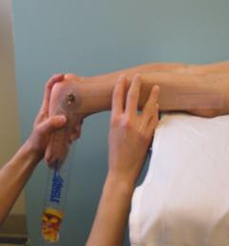
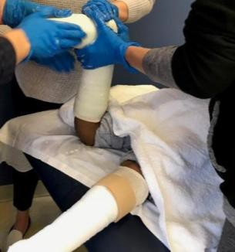
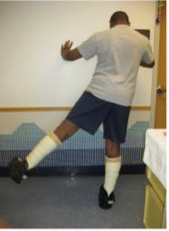
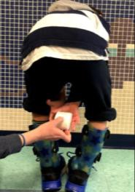
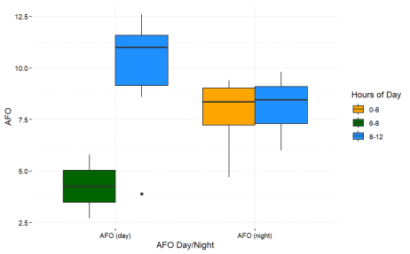
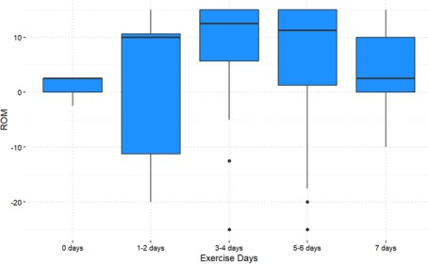
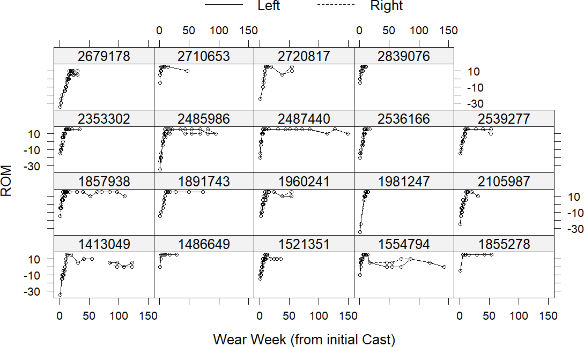
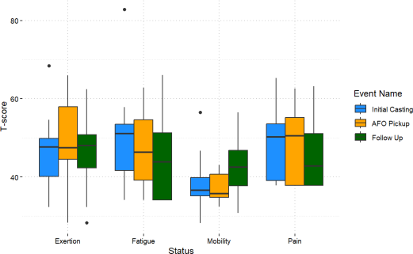
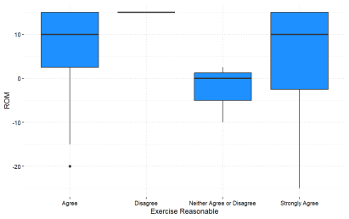
Evaluation of a Comprehensive Serial Casting Program for Long-term Correction of Equinus
Brigid Driscoll, PT, DPT,CO/L, Sara Jerousek, CO/L, Elizabeth O’Riordan, PT, DPT, MS, Bridget Ugaste, PT, DPT
Ann & Robert H. Lurie Children’s Hospital of Chicago, Chicago, IL, USA
Significance Casting Methodology
Serial casting is a treatment option for children with equinus contractures and a toe-toe gait pattern. Standard methodology for serial casting protocols is inconsistent throughout literature, and positive results tend to be short- term (Bauer et al., 2022).
Lurie’s comprehensive program incorporates serial casting, intensive physical therapy, and night/day orthotic management to achieve long-term positive dorsiflexion range of motion and a plantigrade or heel-toe gait pattern.
Our IRB research is an on-going prospective study to investigate the long-term effectiveness of the program in terms of clinical outcomes and patient/family satisfaction. With this prospective study, we are currently building a patient database that includes clinical and patient satisfaction outcomes. This poster demonstrates preliminary results.
Weekly or bi-weekly casts applied by a team of orthotists and physical therapists until 15° of functional DF is achieved.
Cast alignment set at available DF ROM with triplanar corrections, in knee extension, and without any stretch of the gastroc-soleus muscle.
Plaster casts with fiberglass reinforcement
Casts in plantarflexion are accommodated with crepe heels to achieve a plantigrade foot with near vertical tibia
Patients instructed in HEP recommended for 60 minutes/day focusing on correction of sagittal plane alignment of COM over BOS, proximal strengthening of the trunk-hip muscles, and progression of gait with adequate strength and postural control.
Solid day AFOs in neutral DF recommended for 11 hours/day and solid night AFOs in 5-10° DF while sleeping 10-12 hours/day. Compliance monitors embedded in fabrication.
HEP advanced per patient progress and continues for 60 minutes/day, with addition of barefoot ankle PF/DF strengthening.
F/U 1 week, 1month, every 3 months until
cessation of AFOs
Database initiated 1/2022 | Currently in casts | Completed casting & in follow up | Sufficient statistical data
Ongoing enrollment | 1 | 25 | 19
Outcome Measures
PROMIS: Pain, Mobility, Physical Activity & Fatigue
Novel “Family Questionnaire”: Reported compliance & Satisfaction Ankle ROM, iButton data, OGS (not enough data to date)
Reported compliance with AFO use and iButton AFO data
Days in a week exercises were completed related to ROM
Range of Motion Changes Over Time
PROMIS T-Scores to date: Fatigue, Mobility, Pain & Physical Activity
The daily exercise expectations for my child are reasonable
A very special thank you to Mary Weck, PT and Moira Tobin Wickes, orthotist, for their brilliance and innovative thinking that developed our serial casting program.
Bauer, J.P., Sienko, S. and Davids, J.R. (2022) ‘Idiopathic toe walking: An update on natural history, diagnosis, and treatment’, Journal of the American Academy of Orthopaedic Surgeons [Preprint]. doi:10.5435/jaaos-d-22-00419.
bdriscol@luriechildrens.org

